Slide 1


Computer Architecture and Organization
Chapter 6 – Datapath and Control

Slide 2
Chapter Contents
    Basics of the Microarchitecture
    The Datapath
    The Control Section – Microprogrammed
    Developing the Microprogram

Slide 3
The Fetch-Execute Cycle
  • The steps that the control unit carries out in executing a program are:
  (1) Fetch the next instruction to be executed from memory.
  (2) Decode the opcode.
  (3) Read operand(s) from main memory, if any.
  (4) Execute the instruction and store results, if any.
  (5) Go to step 1.

Slide 4
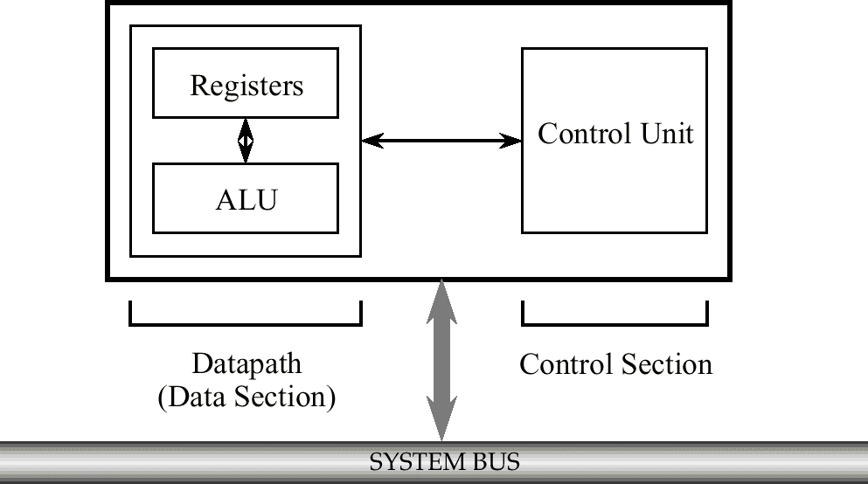
High Level View of Microarchitecture
  • The microarchitecture consists of the control unit and the programmer-visible registers, functional units such as the ALU, and any additional registers that may be required by the control unit.

Slide 5
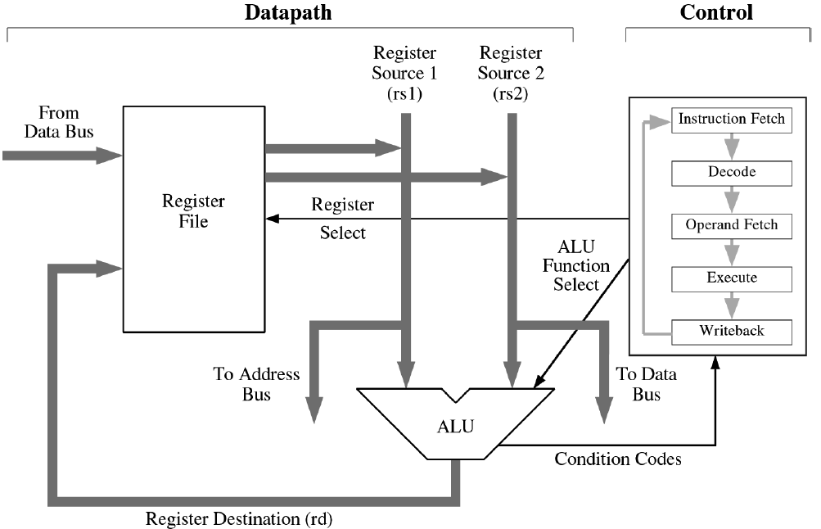
A More Detailed View
Microarchitecture consists of a data section (datapath) which contain registers and an ALU and a control section. Microprogrammed control uses a special-purpose microprogram not visible to the user, to implement operations on the registers an other parts of the machine.

Slide 6
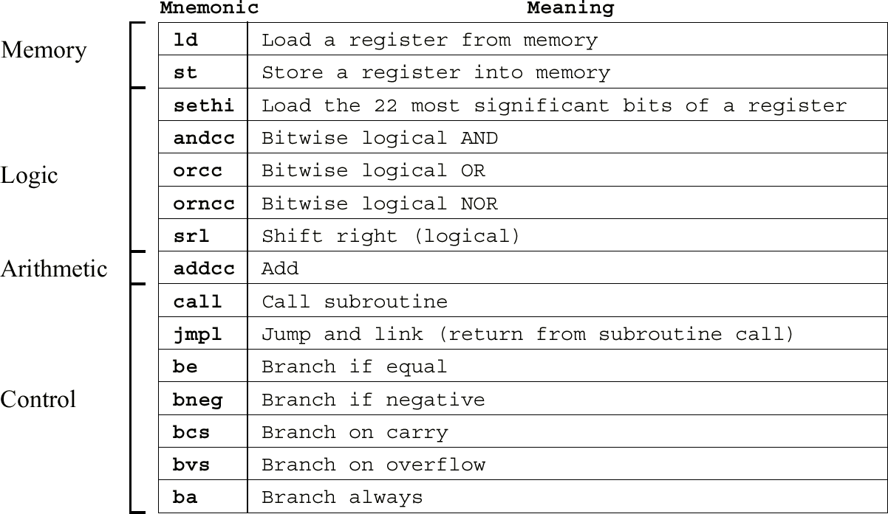
ARC Instruction Subset
There are 15 instructions that are grouped into four format according to the leftmost two bits of the coded instruction. The processor status register %psr is also shown.

Slide 7
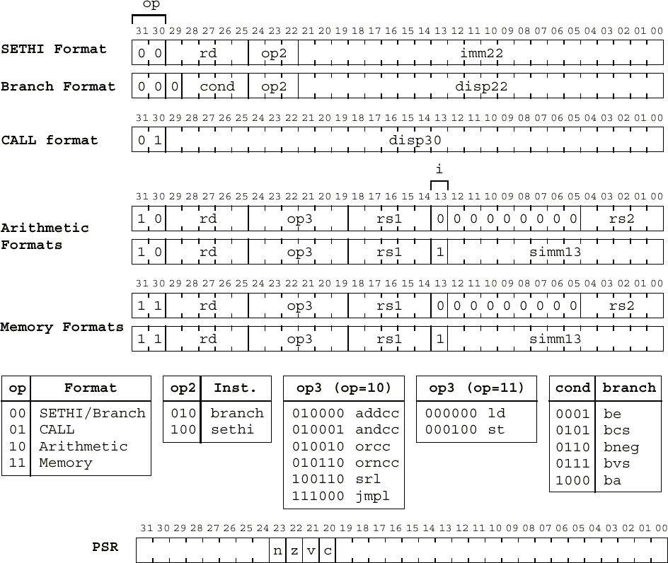
ARC Instruction Formats

Slide 8
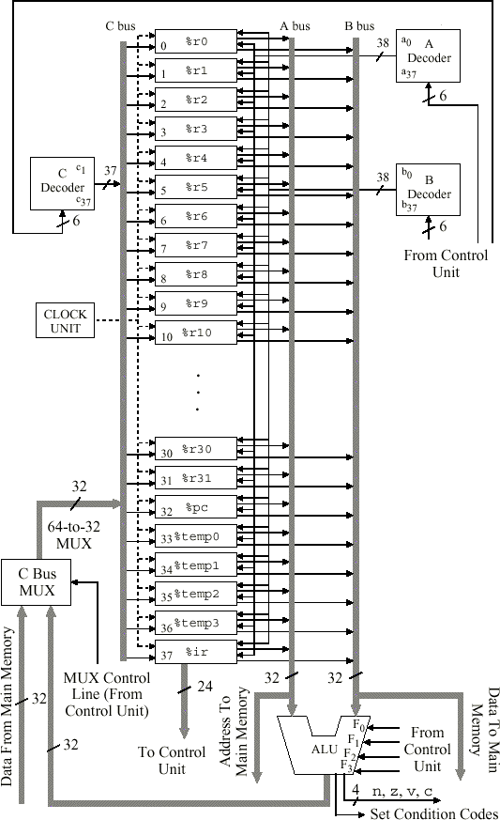
ARC Datapath
Always contains the value 0,cannot be changed
A, B and C → simply register selection
The six-bit inputs to the decode select a single register for each of the A, B, C buses.
2⁶ = 64 possible output from decode but only 38 register
Program counter, which keeps track of the next instruction to be read from the main memory
Are used in interpreting the ARC instruction set and not visible to the user.
User has direct access to %pc only through call and jmpl instruction
Holds the current instruction that is being executed. Not visible to the user.

Slide 9
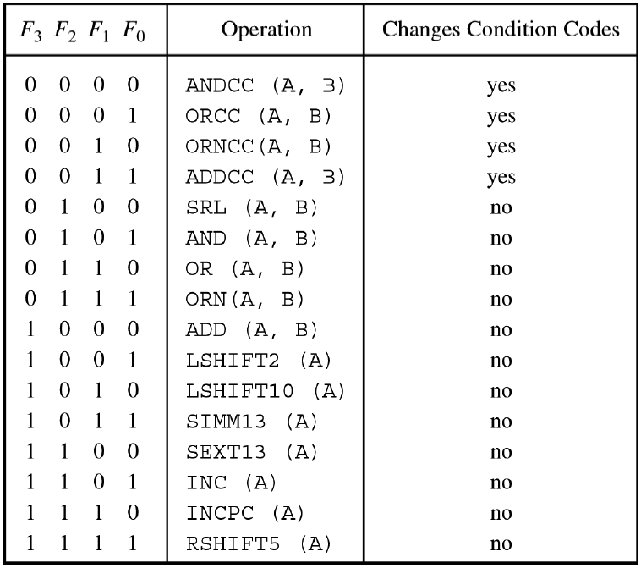
ARC ALU Operations

Slide 10
ARC ALU Operations
Operation | Description
ANDCC and AND | Perform a bit by bit logical AND of corresponding bits on the A and B buses
ORCC and OR | Perform a bit by bit logical OR of corresponding bits on the A and B buses
ORNCC and ORN | Perform a bit by bit logical A + B not of corresponding bits on the A and B buses
ADDCC and ADD | ADDCC and ADD operations carry out addition using two’s complement arithmetic on the A and B buses
SRL (shift right location) | Operation shifts the contents of the A bus to right by the amount specified on the B bus (from 0 to 31 bits). Zero are copied into leftmost bits of the shifted result and the rightmost bits of the result are discarded.
LSHIFT2 and LSHIFT10 | Shift the contents of the A bus to the left by two and 10 bits, respectively Zeros are copied into the rightmost bits.
SIMM13 | Retrieves the least significant 13 bits of the A bus, and places zeros in the 19 most significant bits.
SEXT13 | Performs a sign extension of the 13 least significant bits on the A bus to form a 32 bit word
INC | Increments the value on the A bus by 1
INCPC | Increments the value on the A bus by 4, which is used in incrementing the PC register by one word (four bytes). INCPC can be used on anyr register placed on the A bus.
RSHIFT5 | Shifts the operand on the A bust to the right by five bits. Copying the leftmost bit (the sign bit) into the five new bits on the left. This has the effect of performing a five-bit sign extension.

Slide 11
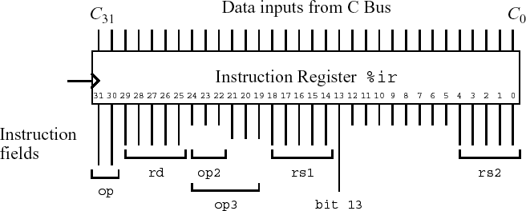
Outputs to Control Unit from
Register %ir

Slide 12
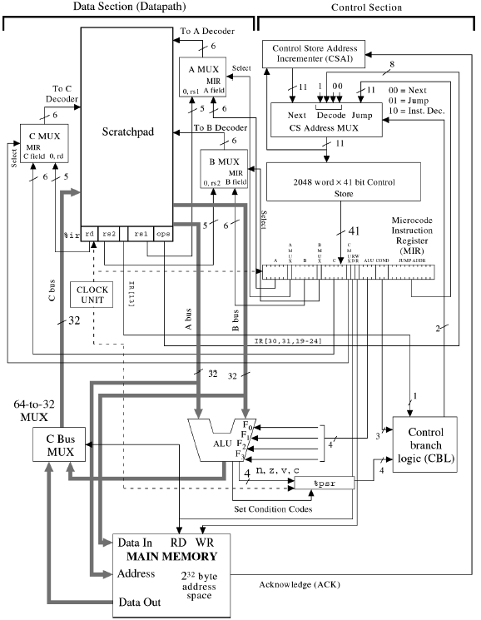
Microarchitecture of the ARC
Read only memory (2048-word x 41 bit) that contains values for all of the lines that must be controlled to implement each user-level instruction.
Each 41-bit word is called a microinstruction
Responsible for fetching microinstructions and executing them.
Microinstruction execution is controlled by the microprogram instruction register (MIR), the processor status register (%psr) and a mechanism to be executed; the control branch logic (CBL) unit and the control store (CS) address MUX.
When the microarchitecture begins operation ( at power on time, cth), a rest circuit (not shown) places the microword at location 0 In the control store into the MIR and executes it. From that point onward, a microword is selected for execution from either the next, the decode or the jump inputs to the CS address MUX, according to the setting in the COND field of the MIR and the output of the CBL logic. After each microword is placed in the MIR…datapath perform operations..

Slide 13
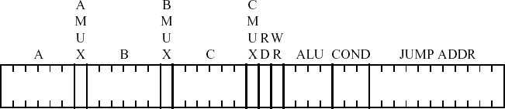
Microword Format

Slide 14
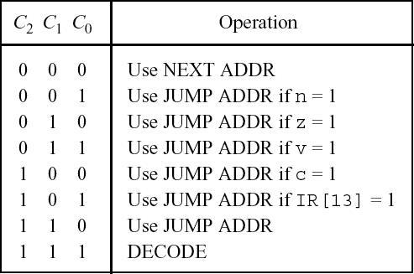
Settings for the COND Field of the Microword
000 – no jump taken
001, 010, 011, 100 or 101 – then a conditional jump is taken
to the control store location in the JUMP ADDR field
n, z, v,or c flag or bit 13 of %ir
IR[13] = bit 13 of the insruction register %ir
COND filed 110 the unconditional jump is taken
111 when an instruction is being decoded

Slide 15
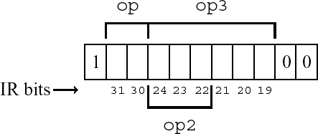
DECODE Format for Microinstruction Address

Slide 16
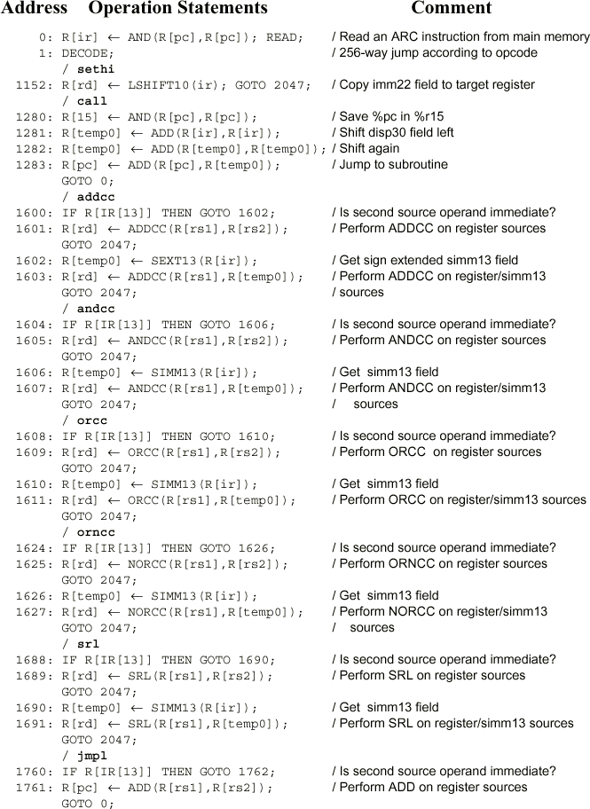
Partial ARC Micro-program

Slide 17
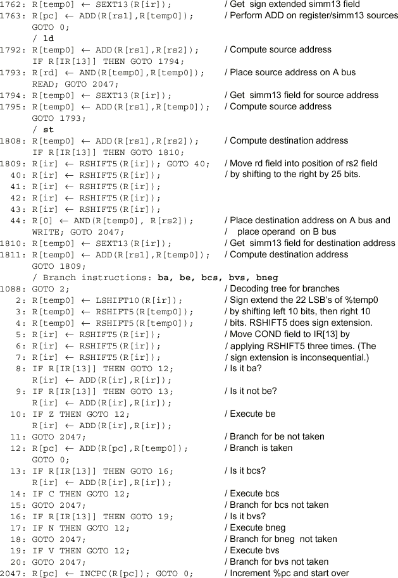
Partial ARC Microprogram (cont’)

Slide 18
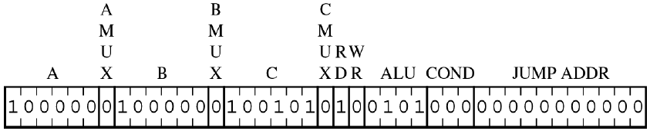
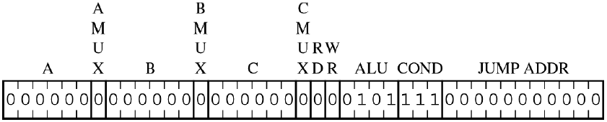
Translating the Microprogram
  0: R[ir] ← AND(R[pc],R[pc]); READ;
  1: DECODE; /256-way jump according to opcode

Slide 19
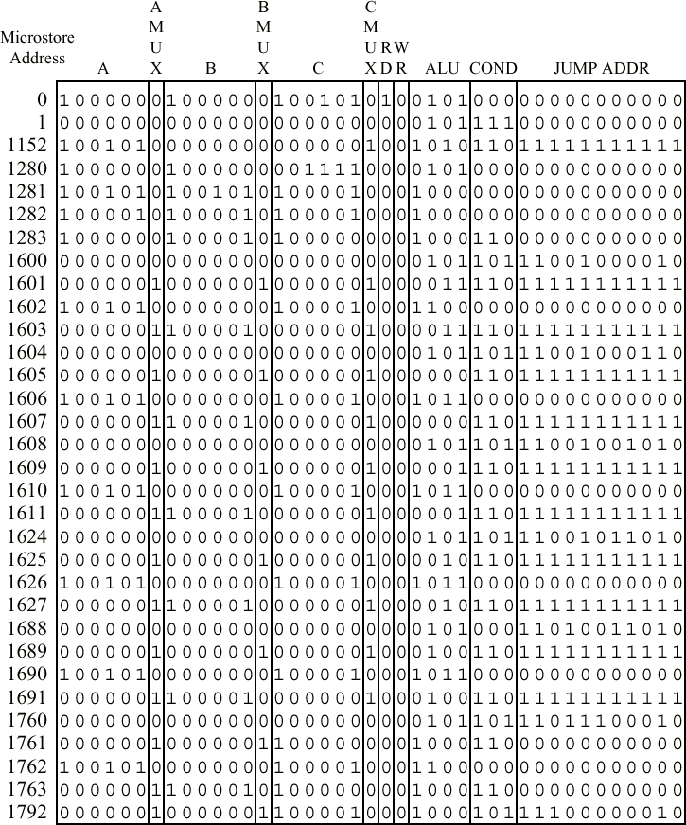
Assembled ARC
Microprogram

Slide 20
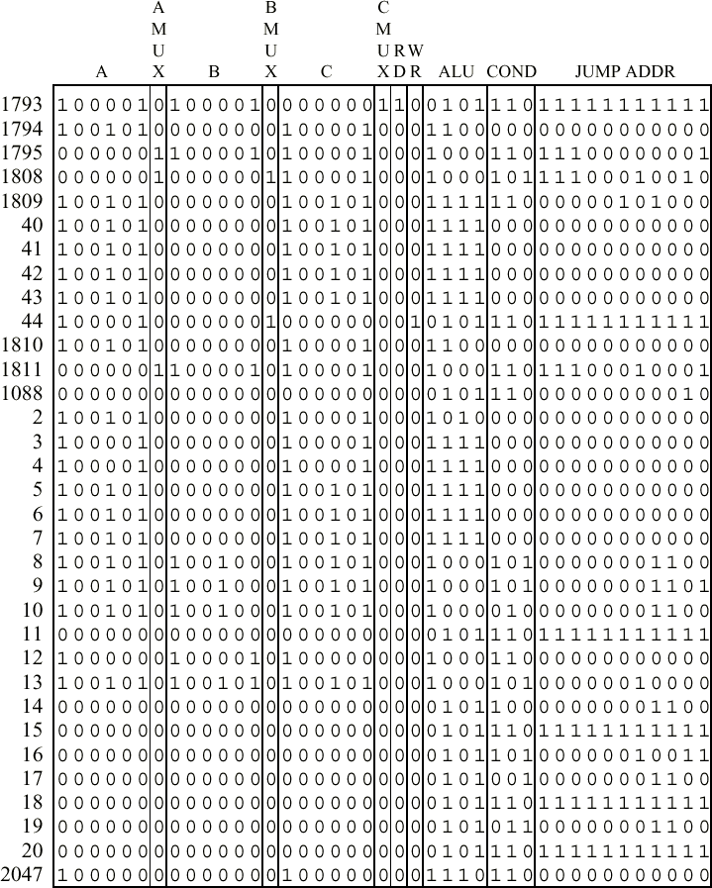
Assembled ARC
Microprogram (cont’)

Slide 21
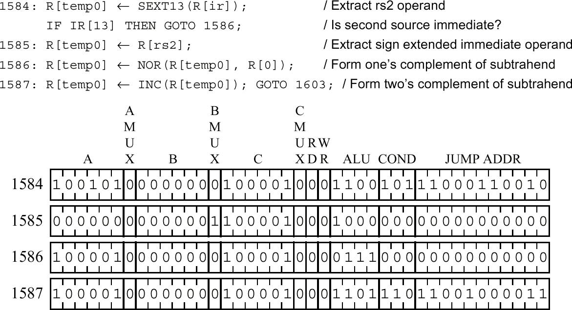
Example: Add the subcc Instruction
  • Consider adding instruction subcc (subtract) to the ARC instruction set. subcc uses the Arithmetic format and op3 = 001100.

